Slide 1
Congolese Aviation Training Center
  An Independent program focused on flight training tailored to the students , the country, and the global needs.
Notes:
This section introduces flight training centers by defining their purpose, exploring the types of institutions involved, and providing an overview of the training programs they offer to aspiring pilots.

Slide 2

Flight Training Center Implementation in D.R. Congo
Notes:
---
This presentation explores the essential foundations, operational components, and future directions of flight training centers. We'll cover their purpose, core training elements, regulatory frameworks, facilities, and the emerging challenges and innovations shaping the future of pilot education.
Image source: Microsoft 365 content library

Slide 3

Agenda Overview
Why?
Uniqueness of the Center
Core Components of Flight Training
  Ground School Curriculum and Theoretical Knowledge
  Simulator Training and Technology Integration
  Inflight Training Case
Challenges and Innovations in Flight Training
Notes:
---
Our discussion will cover an introduction to flight training centers, core training components, certifications and regulations, facilities and instructor roles, and challenges along with innovative trends shaping the future of flight training.
Image source: Microsoft 365 content library

Slide 4
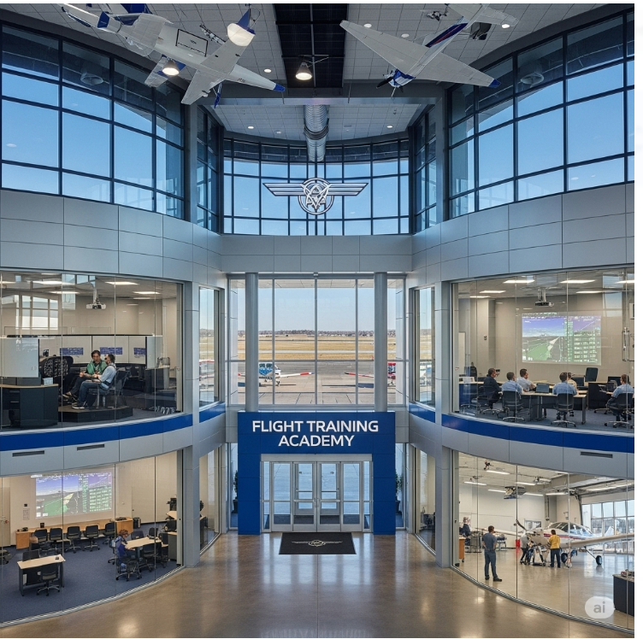
Why the CATC is a Must Have?
Descriptive, Inferential and Qualitative Analysis of Aviation Training and Aviation Safety in Sub-Saharan Africa/Democratic Republic of Congo
  Opening of the country to rural area and increasing need for aerial transport, Intermodal transport solutions, last-mile delivery
  Shortage of pilots(locally and globally)
  Lack of modern training facilities, certified instructors, and internationally recognized curricula.
  Poor Aviation Safety Implementation Performance
  High Cost of Aviation Training
Notes:
---
Flight training centers are specialized institutions dedicated to educating and preparing individuals for careers as professional pilots. They provide structured training programs encompassing theoretical knowledge and practical flight skills necessary for safe and competent aviation.
Image source: Microsoft 365 content library

Slide 5
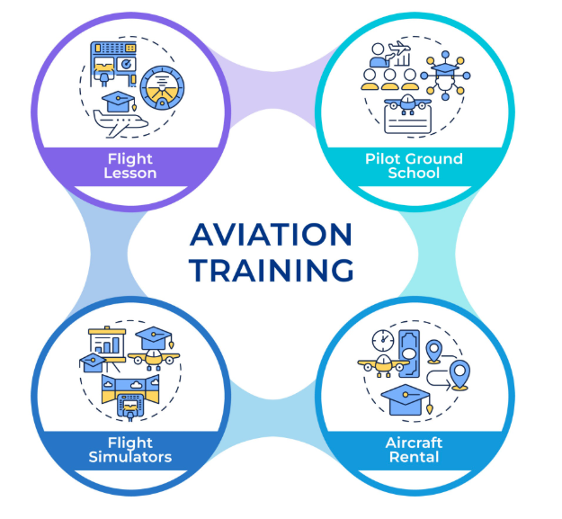
Uniqueness of the Center
  These centers offer structured programs combining theoretical knowledge and practical flight skills for pilot competences that align with international agencies requirements such as ICAO standards (e.g., ATPL, PPL, AME), EASA or FAA, the Congolese Aviation Authority and African Civil Aviation Commission.
  Qualified and experienced flight instructors, ground school instructors, administrative staff, and maintenance personnel
  Infrastructure: Type of aircraft, simulators, classrooms, maintenance hangars, airstrips in remote rural areas. Faculty: Recruitment of certified instructors, continuous professional development
  Multi-purpose building with classroom including state-of-the-art
  audio-visual aids• Gleim Flight Simulators• Unmanned Aircraft System (UAV and platform)
  Aircraft for pilot training (Cessna 152, 172,182) purchase on lease•
  Flight Computers and Navigations tools• Documentations
Notes:
---
Flight training centers are specialized institutions dedicated to educating and preparing individuals for careers as professional pilots. They provide structured training programs encompassing theoretical knowledge and practical flight skills necessary for safe and competent aviation.
Image source: Microsoft 365 content library

Slide 6
Core Components of Flight Training
Notes:
This section covers the critical elements of flight training, including ground school instruction, simulator training, and in-flight practical experience for developing comprehensive pilot competencies.

Slide 7
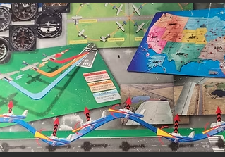
Ground School Curriculum and Theoretical Knowledge
Aerodynamics Fundamentals
  Ground school teaches aerodynamics principles essential for understanding aircraft flight mechanics.
Meteorology Basics
  Students learn weather patterns and their impact on flight safety and planning.
Navigation Techniques
  Training includes navigation methods for accurate course plotting and flight path management.
Aviation Regulations and Human Factors
  Ground school covers aviation laws and human factors influencing pilot decisions and safety.
Notes:
---
Ground school forms the classroom portion of training, covering aerodynamics, meteorology, navigation, aviation regulations, and human factors that are foundational for pilot knowledge and decision-making.
Image source: Microsoft 365 content library

Slide 8
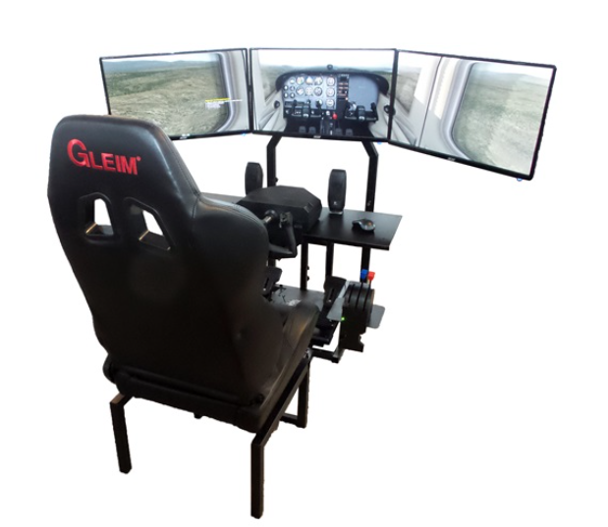
Simulator Training and Technology Integration
Safe Pilot Training
  Simulators offer a risk-free environment for pilots to rehearse procedures and emergency scenarios effectively.
Virtual Reality Integration
  Virtual reality technology enhances simulator realism, providing immersive and interactive pilot training experiences.
Full-Motion Simulators
  Full-motion simulators mimic real aircraft movements, improving pilot preparedness and skill development.
Notes:
---
Simulators provide safe, cost-effective environments for pilots to practice procedures, emergency scenarios, and instrument flying. Modern centers integrate advanced technologies such as virtual reality and full-motion simulators to enhance training realism.
Image source: Microsoft 365 content library

Slide 9

Ground and In-Flight Training Case
Click the picture below to watch the video
Notes:
---
Practical flight training involves supervised flying hours with instructors to develop hands-on skills including aircraft handling, navigation, communication, and emergency management under real-world conditions.
Image source: Microsoft 365 content library

Slide 10
Challenges and Innovations in Flight Training
Notes:
This section explores current challenges such as pilot shortages and diversity, technological advancements, and sustainability initiatives shaping the future landscape of flight training.

Slide 11
Addressing Pilot Shortages and Diversity
Global Pilot Shortage
  The aviation industry is experiencing a significant global shortage of qualified pilots, impacting operations worldwide.
Enhancing Diversity
  Efforts focus on attracting underrepresented groups through inclusive recruitment strategies to diversify the pilot workforce.
Support Programs
  Scholarships and outreach programs support aspiring pilots from diverse backgrounds, encouraging broader participation.
Notes:
---
The industry faces a global pilot shortage and seeks to enhance diversity by attracting underrepresented groups through inclusive recruitment, scholarships, and outreach programs.
Image source: Microsoft 365 content library

Slide 12
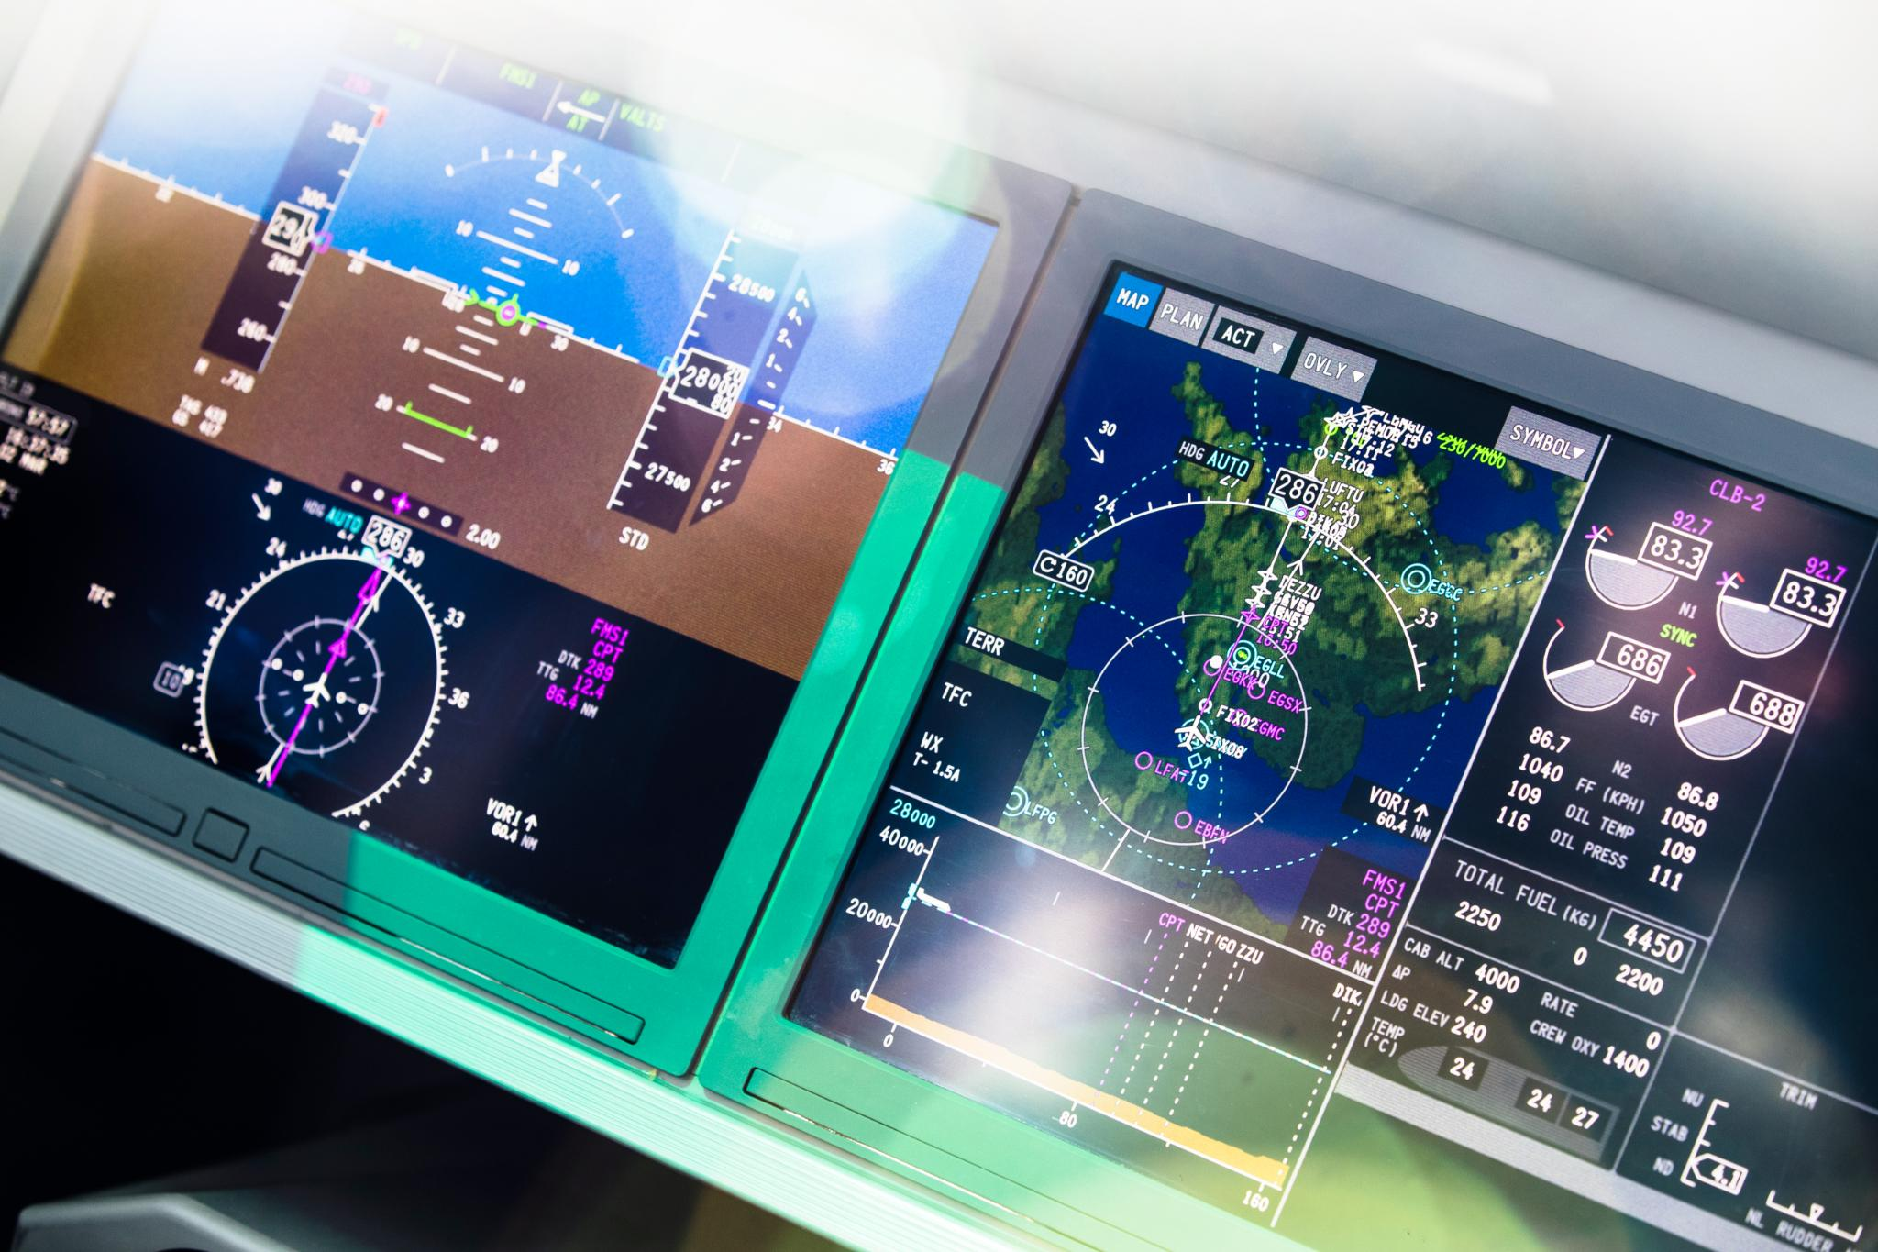
Adapting to New Technologies and Training Methods
Artificial Intelligence Integration
  AI enhances flight training by providing adaptive learning and personalized feedback for trainees.
Advanced Flight Simulators
  Simulators offer realistic practice environments, improving pilot skills and safety without real-world risks.
E-learning Platforms
  Online platforms enable flexible, accessible flight training with interactive and multimedia content.
Competency-based Training
  Training methods focus on mastering specific skills and competencies to ensure pilot readiness and safety.
Notes:
---
Flight training is evolving with the integration of artificial intelligence, advanced simulators, e-learning platforms, and competency-based training approaches that improve efficiency and effectiveness.
Image source: Microsoft 365 content library

Slide 13
Conclusion
Role of Flight Training Centers
Foundations and Operations
Embracing Innovations
Flight training centers are essential in developing skilled and safety-conscious pilots for the aviation sector.
Understanding the core principles and smooth operations is key to successful pilot education.
Incorporating new technologies enables training centers to meet future aviation demands effectively.
Notes:
Flight training centers play a vital role in shaping skilled, safe pilots for the aviation industry. By understanding their foundations, operations, and embracing innovations, these institutions can meet future demands and foster aviation excellence.

